Slide 1

System Performance - 2
Computer System Engineering, Fall 2019. (IPADS, SJTU)
Fighting bottlenecks
Yubin Xia

Slide 2
Review: How to Improve Performance
Step-1. measure the system, and compare it to our system model, to find the bottleneck
Step-2. relax the bottleneck

Slide 3
Review: Performance Metrics
Computer Systems can be viewed as interconnected modules
★ Capacity
★ Latency
★ Throughput
★ Utilization

Slide 4
Review: Latency & Throughput
When processing is serial:
Throughput = 1 / (Latency)
When processing is parallel:
Throughput has no direct relationship with latency
How to improve throughput? Reduce latency & Increase paralleling

Slide 5
Review: Improving Performance at 3 Layers
Get faster hardware
Fix application: better algorithm, fewer features (not in CSE)
General system optimization techniques:
Batching
Caching
Concurrency
Parallelism (scheduling)
Application
System
Hardware

Slide 6
Fighting Bottlenecks

Slide 7
Why Performance Bottleneck?
1. Physical limitation
Speed of light
The capacity of memory
…
2. Sharing
Several users share a device
Several clients share a server

Slide 8
How to Improve Performance?
1. Measure the system to find the bottleneck
2. Relax the bottleneck
Batch requests
Cache data
Exploit concurrency
Exploit parallelism (by scheduling)

Slide 9
Batching
Frequently it is possible to group requests for more efficiency
Amortize overheads of processing
Schedule requests for better performance
Examples: N messages vs. one message with N requests Disks:
Always transfer a bunch of bytes (sector or block)
Schedule the disk motions

Slide 10
Caching
Use knowledge of workload: memory abstractions
Keep common requests in a fast local memory
Check the local memory every access
CPU cache – Cache 1ns, Memory 100ns, 90% hit rate
AverageLatency = 0.9 x 1ns + 0.1 x 100ns = 10.9 ns (100ns -> 10.9ns)
Used everywhere there are memory abstractions
Processors, file systems, TLBs, browsers, DNS, etc.

Slide 11
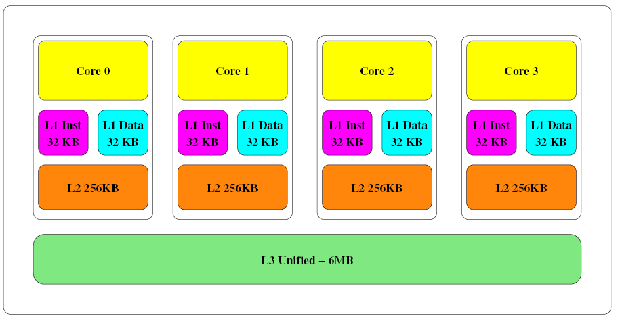
Memory Hierarchy
Intel Core-i5 Memory Architecture

Slide 12
Dallying
Procrastination sometimes helps
Temp files – deleted before written to disk
Examples:
Caches – Write back policy: write absorption
Database transactions – group commit
Might hold your ATM request until others arrive to do batching

Slide 13
Speculation
Guessing at an operation and performing it ahead a time
Need to be able to undo changes if wrong
Examples:
Processors guess at branches, memory access
File systems guess at next file block needed (prefetching)
Easier if space of possibilities is small
Branch prediction versus value prediction

Slide 14
Speculative Execution in CPU
This is the process of executing an instruction in anticipation that it might be used
This provides instruction level parallelism
For instance in a conditional statement, both the instructions in a condition might be executed
Depending on the condition, only one of the execution is retired or committed
The other instruction is flushed from the pipeline
Tomasulo algorithm describes these details

Slide 15
Out-of-order Execution
Multiple instructions executed regardless of the actual program order
lw $3, 100($4) in execution, cache miss
sub $5, $6, $7 can execute during the cache miss
add $2, $3, $4 waits until the miss is satisfied
The instructions are fetched, decoded and prepared for execution and pushed into a reservation station
Those instructions without data dependencies will execute in no specific order
Others will stall until dependency is satisfied (resolving data hazards)

Slide 16
Challenges
Batching, dallying, and speculation introduce complexity
They introduce concurrency
Coordination is difficult to get right

Slide 17
Case: I/O Bottleneck

Slide 18
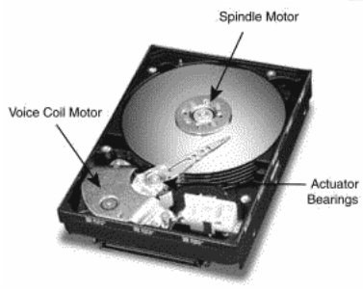
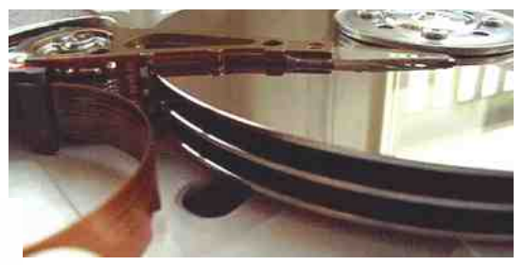
The I/O Bottleneck
Bits read from a disk encounter two potential transfer rate limits:
The rate at which bits spin under the heads on their way to a buffer
The rate at which the I/O channel or I/O bus can transfer the contents

Slide 19
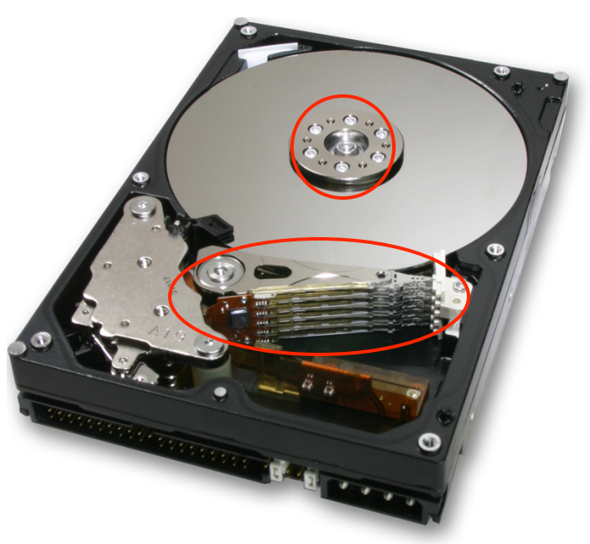
The I/O Bottleneck
Average seek latency: about 8 milliseconds
Time to move the head over 1/3 of the disk
The average rotational latency: 4.17 milliseconds
The disks spin at 7200 rotations/minute
One rotation every 8.33 milliseconds (60/7200)
On average, the disk has to wait a half rotation for the desired block to be under the disk head

Slide 20
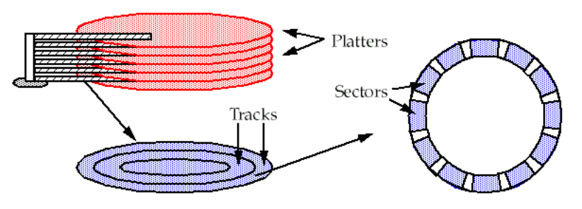
A Typical Modern 400 Gigabyte Disk
Has 16,383 cylinders, or about 24 megabytes per cylinder
Would have 8 two-sided platters and thus 16 read/write heads
Would be 24/16 = 1.5 megabytes per track
When rotating at 7200 revolutions per minute (120 per second)
The bits will go by a head at 180 megabytes per second (1.5 x 120)

Slide 21
Bottleneck
The IDE bus: 66 MB/S is common
The Serial ATA-3 bus: 6 Gbps
With IDE bus: The electronics would be the bottleneck
at 66 MB/S
With SATA-3 bus: The mechanics would be the bottleneck
at 180 MB/S

Slide 22
Latency of 4-KB Data Accessing (Using IDE)
The latency of reading a 4 kilobyte block chosen at random:
avg seek time + avg rotation latency + transmission of 4 kilobytes
= 8 + 4.17 + (4 / (66 × 1024)) × 1000 milliseconds
= 8 + 4.17 + 0.06 milliseconds
= 12.23 milliseconds
The throughput for reading randomly-chosen blocks one by one is:
= 1000/12.23 × 4 kilobytes per second
= 327 kilobytes/second

Slide 23
Round-1: No Optimization
1 in ← OPEN ("in", READ) // open "in" for reading
2 out ← OPEN ("out", WRITE) // open "out" for reading
3
4 while not ENDOFFILE (in) do
5 block ← READ (in, 4096) // read 4 kilobyte block from in
6 block ← COMPUTE (block) // compute for 1 millisecond
7 WRITE (out, block, 4096) // write 4 kilobyte block to out
8 CLOSE (in)
9 CLOSE (out)
reading 4 kilobyte + 1 millisecond of computation + writing 4 kilobyte
= 12.23 + 1+ 12.23 milliseconds
= 25.46 milliseconds

Slide 24
Round-2
Modify the file system
to layout the blocks of a file contiguously
to prefetch an entire track of data on each read
Average seek time + 1 rotational delay
= 8 + 8.33 milliseconds = 16.33 milliseconds

Slide 25
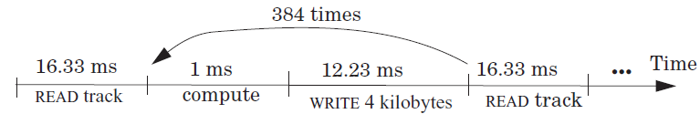
Round-2
File system issues 1 read request per 384 (1.5 MB per track / 4 KB) loop iterations
The average time for 384 iterations is:
reading 1536 kilobyte + 384× (1 millisecond of computation + writing 4 kilobyte)
= 16.33 + 384 × (1 + 12.23) millisecond
= 16.33 + 5080.32 milliseconds
= 5096.65 milliseconds
Thus, the average time for a loop iteration is 5096.65/384 = 13.27 milliseconds

Slide 26
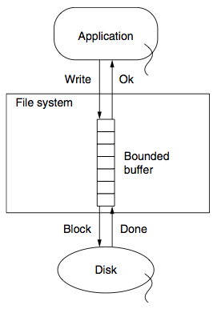
Round-3
Improve by dallying & batching write requests
Write to buffer in RAM and flush when buffer is full
Latency = (16.33 + 384 + 16.33)/384 milliseconds
= 1.09 milliseconds

Slide 27
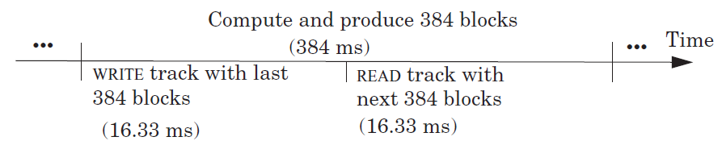
Round-4
Prefetch the next track before the 385th READ
Overlap computation and I/O completely
The average time around the loop is 1 millisecond
The bottleneck now is the CPU

Slide 28
Cache Policies
Multi-level Memory

Slide 29
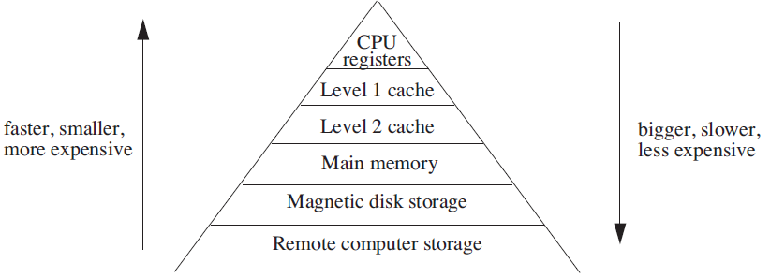
Analyzing Multilevel Memory Systems
Only consider the adjacent pair of levels
View it as a two level multilevel memory system
The 1st is primary device, the 2nd is secondary device

Slide 30
Locality of Reference and Working Sets
In many situations most memory references are to a small set of addresses for significant periods of time
As the application progresses, the area of concentration of access shifts, but its size still typically remains small
Called "locality of reference"
Temporal locality and spatial locality
Thrashing: repeated movement of data back and forth between two levels

Slide 31
Multilevel Memory Management Policies
Each level of multilevel memory system can be characterized by 4 items
The string of references directed to that level
The bring-in policy for that level
The removal policy for that level
The capacity of the level

Slide 32
Page-removal Policies
First-in, first-out (FIFO) page-removal policy
Remove the page that has been in the primary device the longest
Belady's anomaly
Performance drops with a larger primary device capacity!
Optimal (OPT) page-removal policy
Choose for removal the page that will not be needed for the longest time
Least-recently-used (LRU) page-removal policy
The page in the primary device that has not been used for the longest time

Slide 33
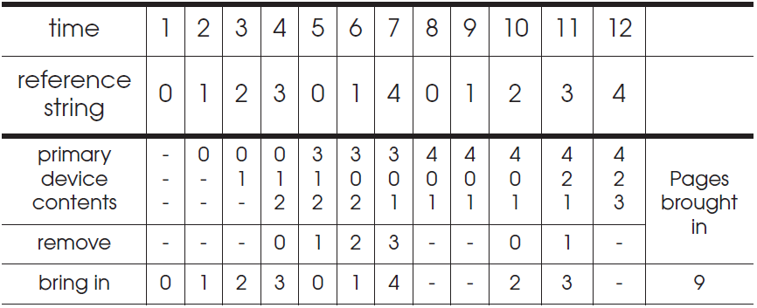
First-in, First-out (FIFO) Page-Removal Policy
The page for removal is the one that has been in the primary device the longest

Slide 34
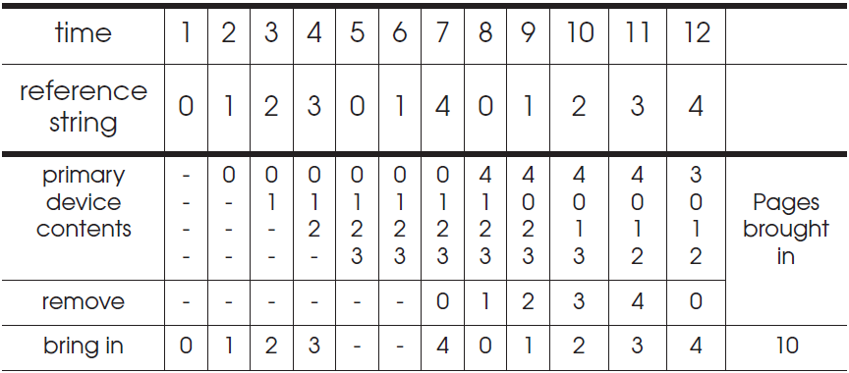
Belady's Anomaly
Increase of missing-page exception numbers with a larger primary device capacity

Slide 35
Stack Algorithms
Subset property
For the optimal policy, at all times, the pages it keeps in the 3-page memory is a subset of that it keeps in the 4-page memory
No Belady's anomaly if subset property holds
At all times and for every possible capacity of primary device, it creates a total ordering for pages at a given time

Slide 36
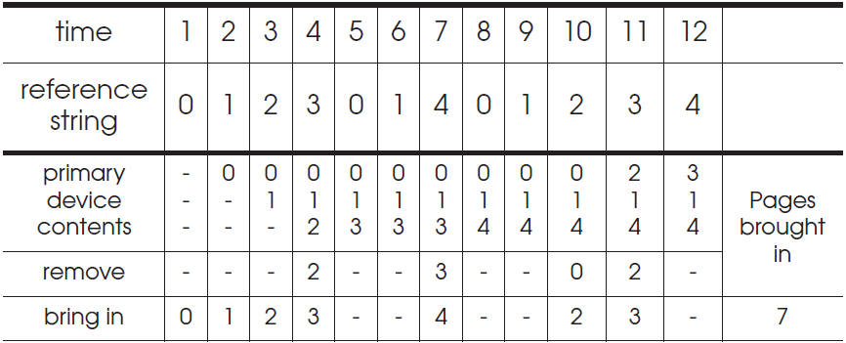
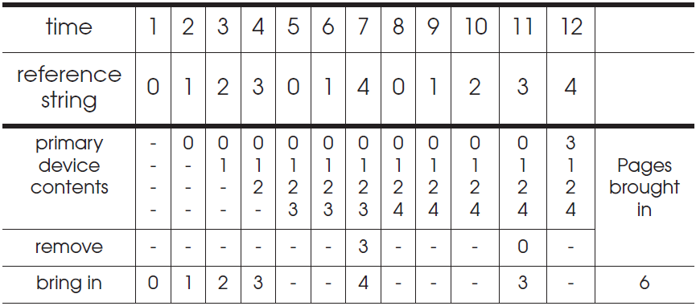
OPT (Optimal) Page-Removal Policy
Always choose for removal the page that will not be needed for the longest time

Slide 37
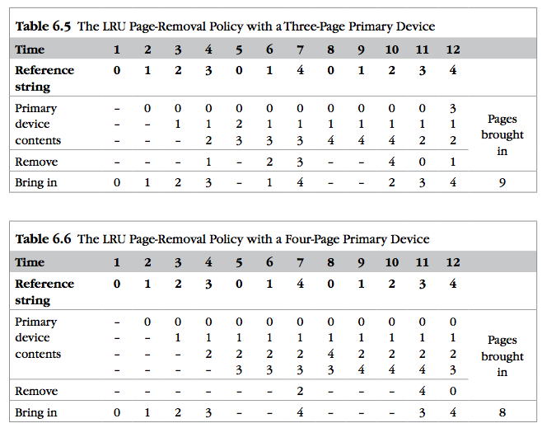
LRU
It is confirmed as an error, in errata part I.
Notes:
It is confirmed as an error, in errata part I.

Slide 38

Least-recently-used (LRU) Page Removal Policy
A program that runs from top to bottom
the virtual memory that is larger than primary device
LRU: always evicts exactly the wrong page
Most-recently-used (MRU) page-removal policy

Slide 39
Comparative Analysis of Different Policies
Ways of deciding the following two things:
How large the primary memory device should be?
Which page removal policy to use?
Collecting traces of the reference strings of typical programs
Simulate the multilevel memory manager with:
Different configurations - Size of primary device
Page removal policy - Traces of memory access

Slide 40
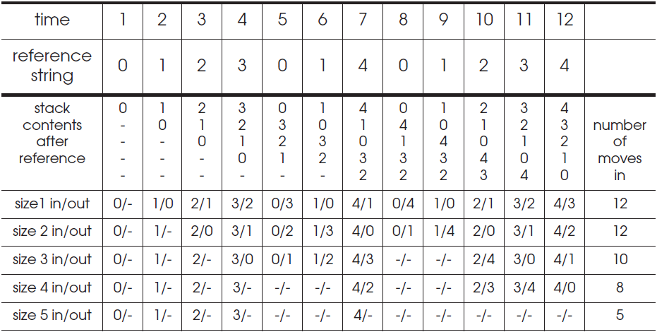
Stack Algorithms for LRU
It can perform a simulation for all possible primary memory size with a single pass through a given reference string

Slide 41
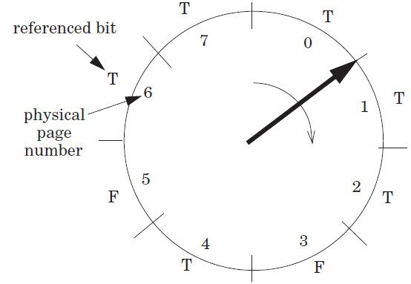
Efficiency of Page-Removal Policies
Clock page-removal algorithm
Base on a hardware setting bit
Reference bit
Move clockwise
If T, set F
Choose as the victim otherwise
Random removal policy
For TLB
Directed mapping

Slide 42
Scheduling

Slide 43
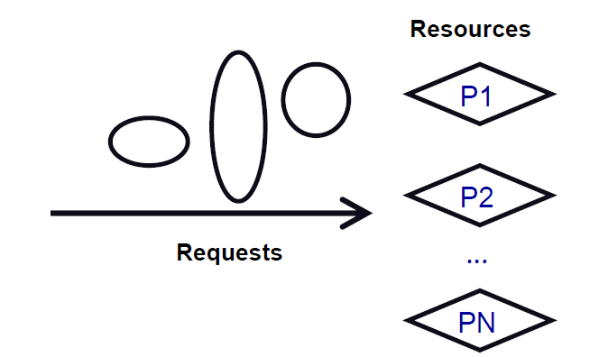
Scheduling
Algorithm that assigns requests to resources
Processor time – Threads
Physical memory – Address spaces
Printers – Printer jobs
Disks – Disk requests
Networks – Packets
Memory bus – Memory requests

Slide 44
Challenges of Scheduling
Easy, if number of requests ≤ resources
Difficulty: Lack of information
Packet scheduling and streaming media
Difficulty: Lack of mechanism to enforce policies
Give high priority to CPU, but can't get to disk or network
Difficulty: Getting mechanism right
Many schedulers break rather than gracefully degrade under load

Slide 45
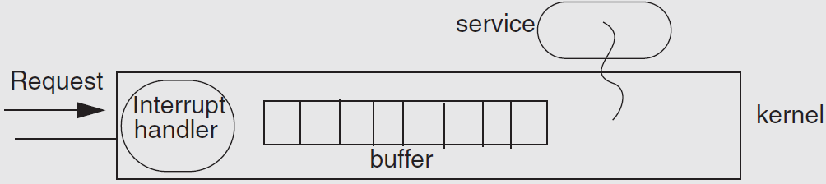
Example: Livelock under Overload
Web news server overloaded
Most of the time is spend to handle interrupt and drop requests
No progress at all!

Slide 46
The Ideal Scheduler
Mini latency: How long a service takes? E.g., Move mouse, cursor moves
Max throughput: Max jobs / time. E.g., Web server pages/second
Low overheads: Scheduler doesn't use any resources
Fairness: everyone gets to make progress, no one starves
Scales linearly up to capacity: Graceful handling of overload
System-level goal may conflict with the needs of individual threads
System: minimal preemption
Apps: finish as soon as possible

Slide 47
Measuring the Request's Response
Turn-around time: The length of time from when a request arrives at a service until it completes
Response time: The length of time from when a request arrives at a service until it starts producing output
Waiting time: The length of time from when a request arrives at a service until the service starts processing the request

Slide 48
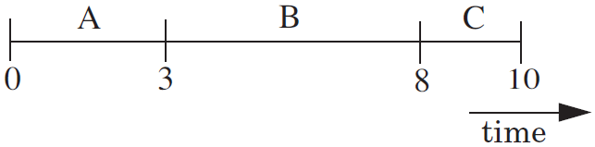
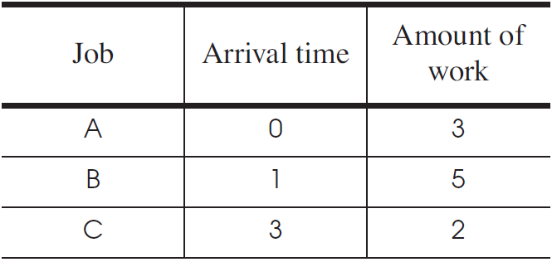
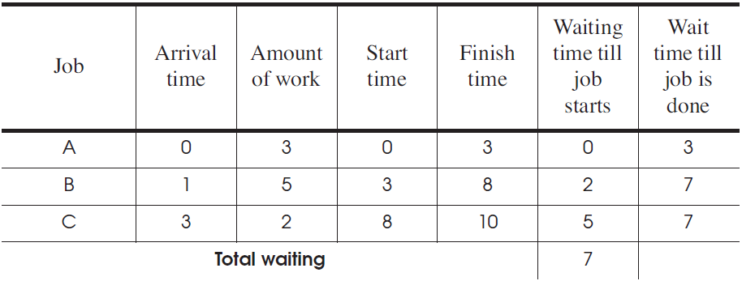
First Come First Server (FCFS)
Fairness paramount
Good for printer scheduler

Slide 49
First Come First Server (FCFS)
For the processor
One thread that periodically waits for I/O but mostly computes
Several threads that perform mostly I/O operations
For the scheduler
It runs the I/O-bound threads first
Then runs the computation intensive thread
All quickly finished computations and waiting for I/O

Slide 50

Convoy Effect
When I/O devices are idle
The I/O-bound threads will quickly finish computations and start I/O
The processor-bound thread will run for a long time
I/O-bound operations will finish I/O and queuing for computation
All the I/O devices will become idle!
When processor is idle
The processor-bound thread finishes computation and starts I/O
The I/O-bound threads will quickly finish computations and start I/O
Processor will become idle!
CPU
Device

Slide 51
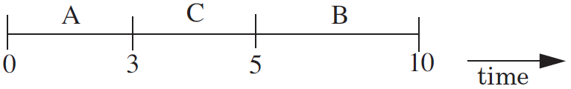
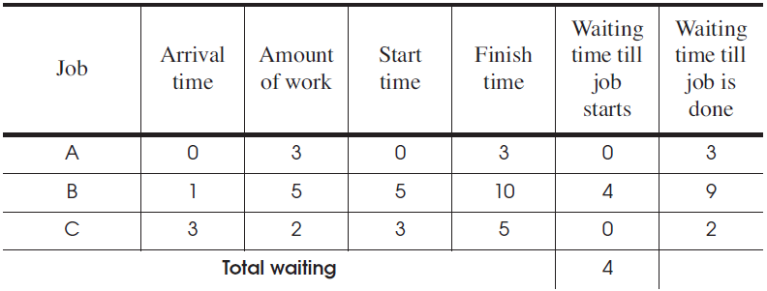
Shortest-Job-First
Chooses the job that has the shortest expected run time
Require a prediction of the running time of a job before running
Starvation: several short jobs makes a long job starve

Slide 52
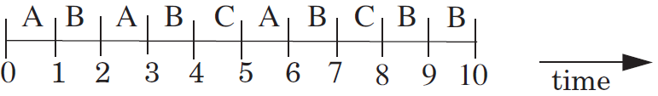
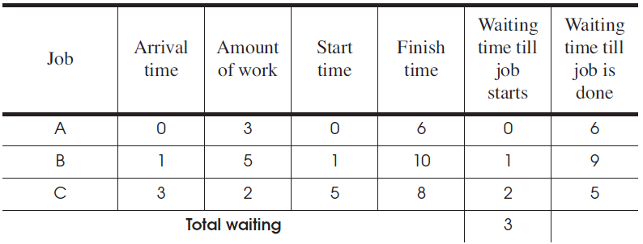
Round-Robin
Select the first job from queue as in the first-come first-serve policy
Stop the job after some period of time, and select a new job

Slide 53
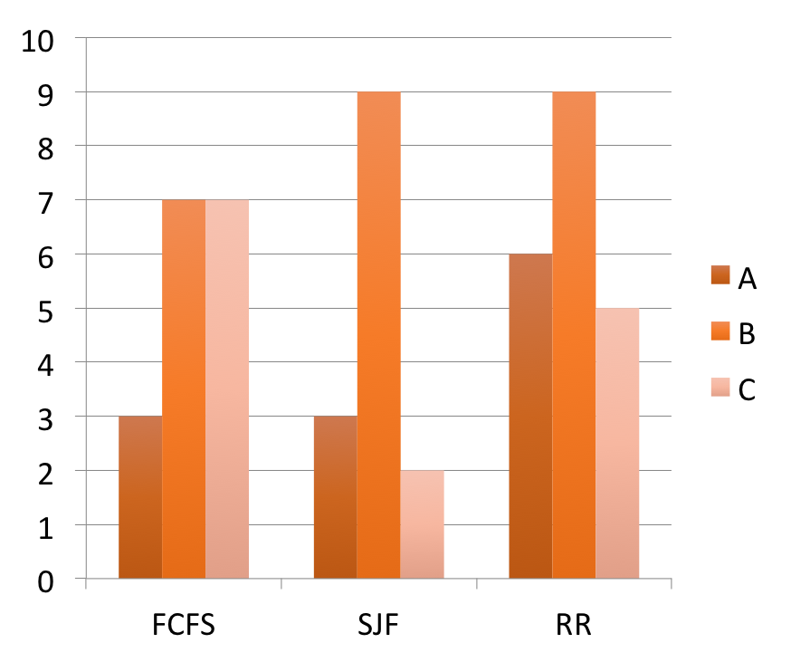
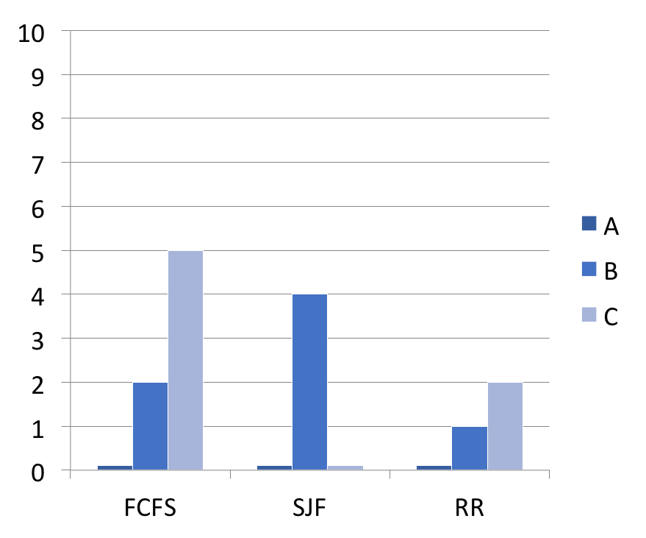
Comparing the Three Policies
Wait time before start
Wait time till done
Amount of work: A:3, B:5, C:2

Slide 54
Priority Scheduling Policy
Priority Scheduling Policy
Assign each job a priority number (static vs. dynamic)
Select the job with the highest priority number
Must have some rule to break ties
Modern CPU schedulers have
Priorities: Run job with the highest priority
Round Robin: Alternate among jobs of same priority, preempt a job if it holds CPU too long

Slide 55
CPU Scheduling Policy
Assign priorities to jobs
Give high priorities to I/O-bound jobs
Give low priorities to CPU-bound jobs
Handles I/O-bound and CPU-bound jobs nicely

Slide 56
CPU Scheduling Policy
Challenge: distinguish I/O-bound and CPU-bound
Look at past behavior to predict the future
Linux: Priority of job is function of amount of CPU it has used
Counterintuitive:
More CPU a job uses/needs, the lower its priority
The less CPU it uses, the higher its priority
Avoids starvation problems: Not running gives task a higher priority

Slide 57
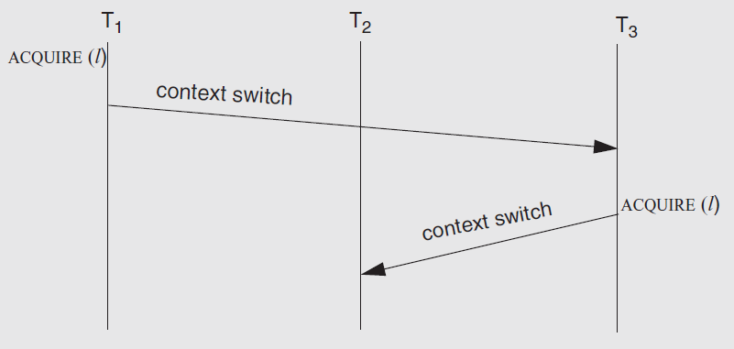
The Priority Inversion Problem
Problem: what if a high priority thread waits for a low priority one which holding a lock?
Solution: priority inheritance

Slide 58
Real-Time Scheduling
Missed deadline = incorrect behavior
Soft real time: Display video frame every 30th of sec
Hard real time: "apply-breaks" process in your car
Scheduling more than one thing: memory, network bandwidth, CPU all at once

Slide 59
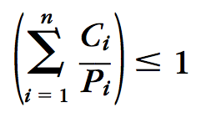
Earliest Deadline First (EDF)
Keep the queue of jobs sorted by deadline
Run the first of the queue
Minimize the total lateness of all the jobs
How to know deadline?
Specified by tasks themselves
In the form of (C, P), C for second, P for period
The scheduler rejects new task if sum(Ci/Pi) > 1

Slide 60
Disk Scheduling: Goals
Minimize time spent waiting on disk mechanisms
Moving the disk arm
Waiting for sector to rotate under disk heads
Fairness
Should not make requests wait too long

Slide 61
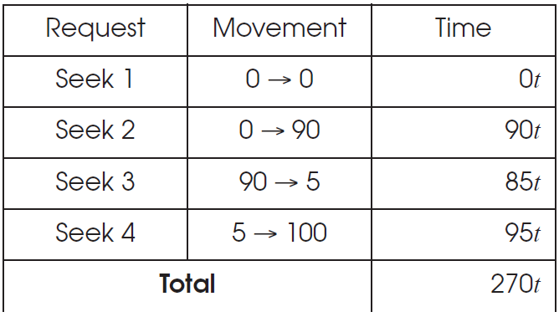
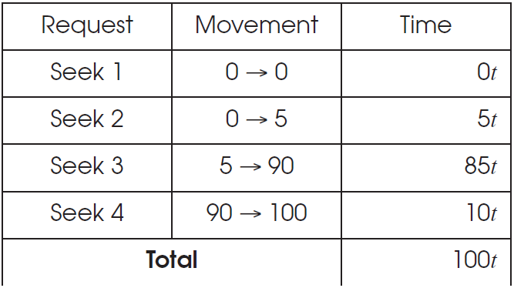
Disk Scheduling
First-come first-serve
Elevator Algorithm

Slide 62
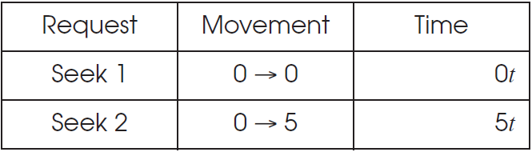
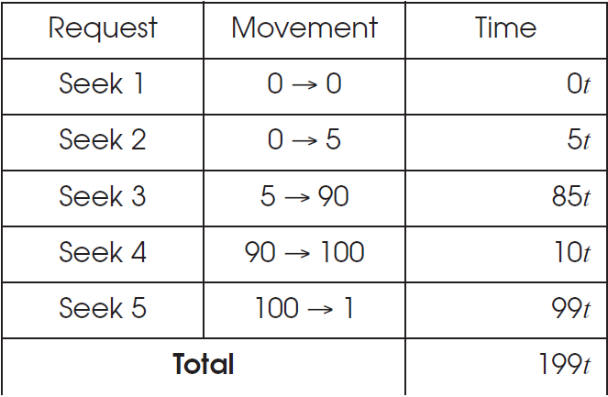
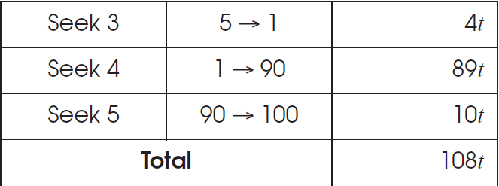
Disk Scheduling
Shortest-Seek-First
Elevator Algorithm

Slide 63
Performance VS. Security

Slide 64
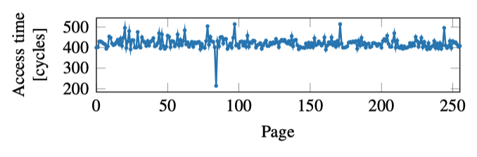
Cache Side Channel
Infer data by memory access time!
if (x)
mov %eax a[0];
else
mov %eax a[1];

Slide 65
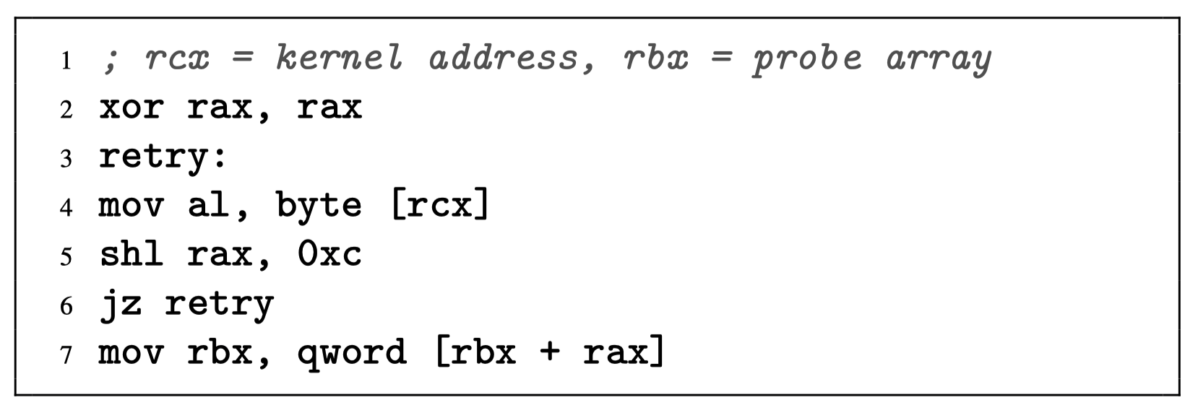
The Meltdown Vulnerability
An inaccessible kernel address is moved to a register, raising an exception.
Subsequent instructions are executed out of order before the exception is raised, leaking the data from the kernel address through the indirect memory access.

Slide 66


The Meltdown Vulnerability
key = 0x01
Mapped with kernel privilege in page table
Kernel
User
Access key
Permission Error!

Slide 67

Meltdown
key = 0x01
Mapped with kernel privilege in page table
Kernel
User
Meltdown
Can access key!

Slide 68

Meltdown
CPU
Instruction
Effect
Cache
Memory
key = 0x01
Kernel
User
Meltdown

Slide 69
Meltdown
CPU
Instruction
Effect
Permission Error!
1
Load key, %rax
%rax = 1
Reorder
Execution
Load buf[%rax], %rbx
Access buf[1]
2
Cache
Memory
key = 0x01
Kernel
Key = 1
… | buf[0] | buf[1] | buf[2] | … | buf[n] | …
User
Meltdown
buf
(Attack buffer)

Slide 70
Meltdown
CPU
Instruction
Effect
Permission Error!
1
Load key, %rax
%rax = 1
Reorder
Execution
Load buf[%rax], %rbx
Access buf[1]
2
Rollback status
w/o cache status!
Exception
3
Cache
Memory
key = 0x01
Kernel
2
Key = 1
buf[1]
… | buf[0] | buf[1] | buf[2] | … | buf[n] | …
2
User
Access
buf[1]
Fill buf[1]
to cache
Meltdown
buf
(Attack buffer)

Slide 71
Meltdown
CPU
Instruction
Effect
Permission Error!
1
Load key, %rax
%rax = 1
Attacker finds that buf[1] is in the cache, so that key equals to 1!
Reorder
Execution
Load buf[%rax], %rbx
Access buf[1]
2
Rollback status
w/o cache status!
Exception
3
Cache
Memory
key = 0x01
Kernel
2
Key = 1
buf[1]
… | buf[0] | buf[1] | buf[2] | … | buf[n] | …
2
User
Access
buf[1]
Fill buf[1]
to cache
Meltdown
buf
(Attack buffer)

